Slide 1
Quiz Maker
A final project presentation by Oliver Mustoe

Slide 2

What did I make?
A Python program that would allow a user to:
Create a Quiz
Saved to CSV file
Edit a created Quiz
Take a created Quiz
Inspired by other quiz makers such as Quizlet

Slide 3
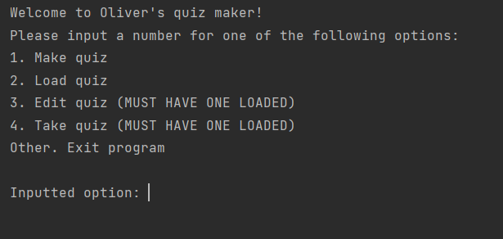
How does my Quiz Maker work?
User starts at a menu screen where they are given to option to:
Make a quiz
Load a quiz
Edit a quiz
Take a quiz

Slide 4
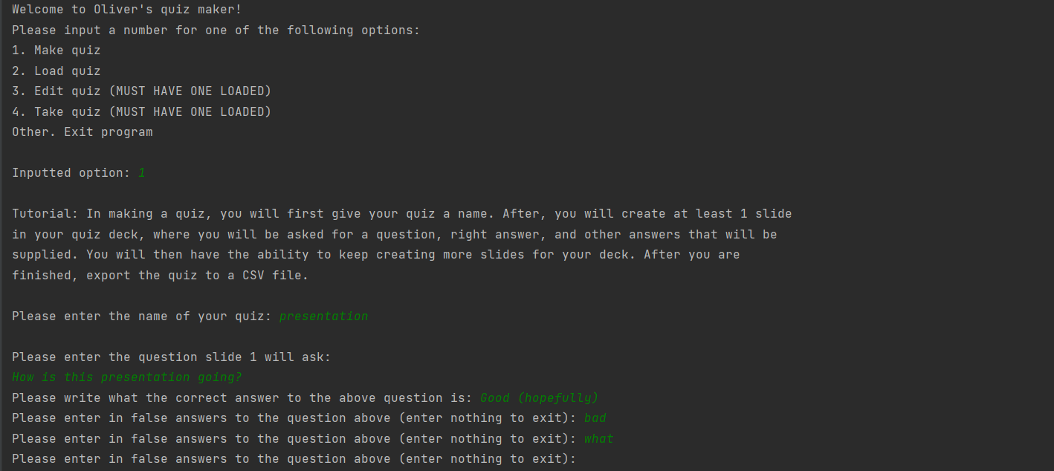
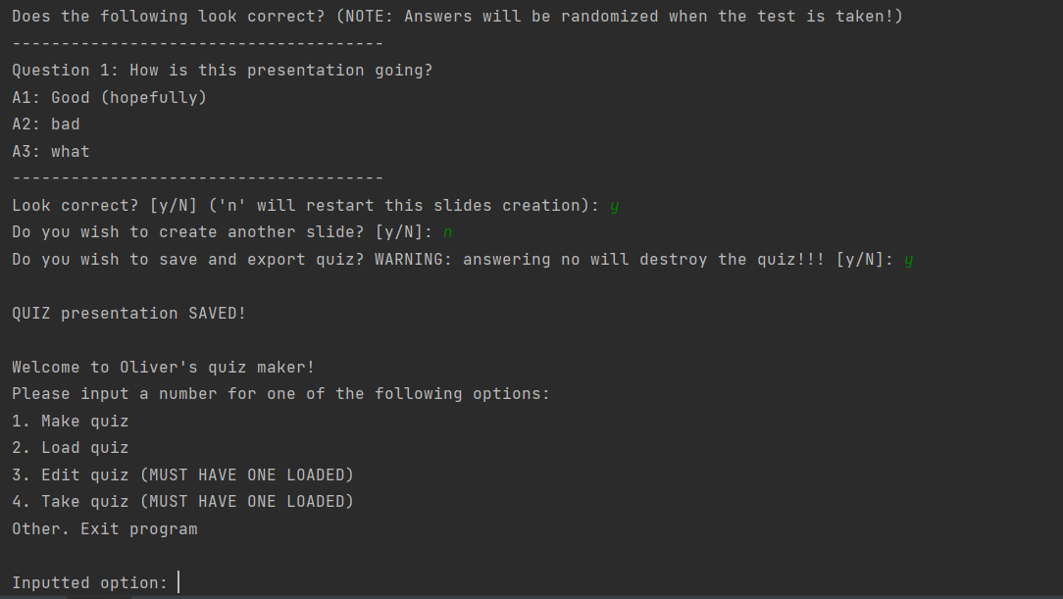
How does my Quiz Maker work?
When making a quiz, a user will supply a:
Name
Slide Question
Slide Right answer
Slide Series of false answers
Throughout the user will be given the ability to change options about the quiz (such as restarting a slide)
Finally the quiz will be exported in CSV format

Slide 5
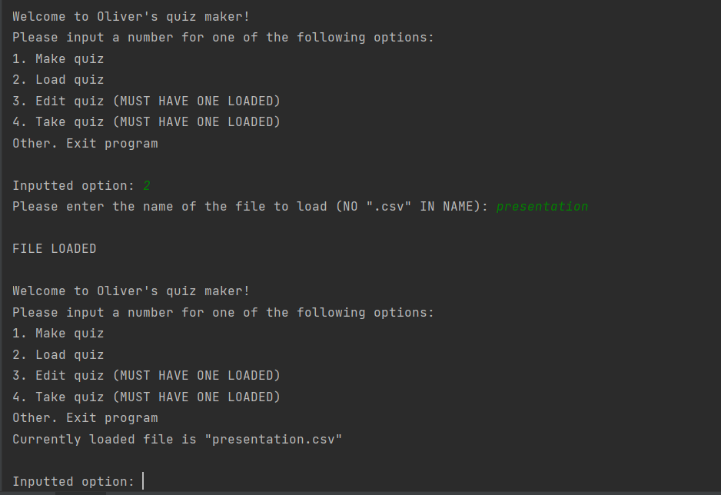
How does my Quiz Maker work?
When Loading a quiz, a user
Will supply a name of a csv file and it will be saved in the file

Slide 6
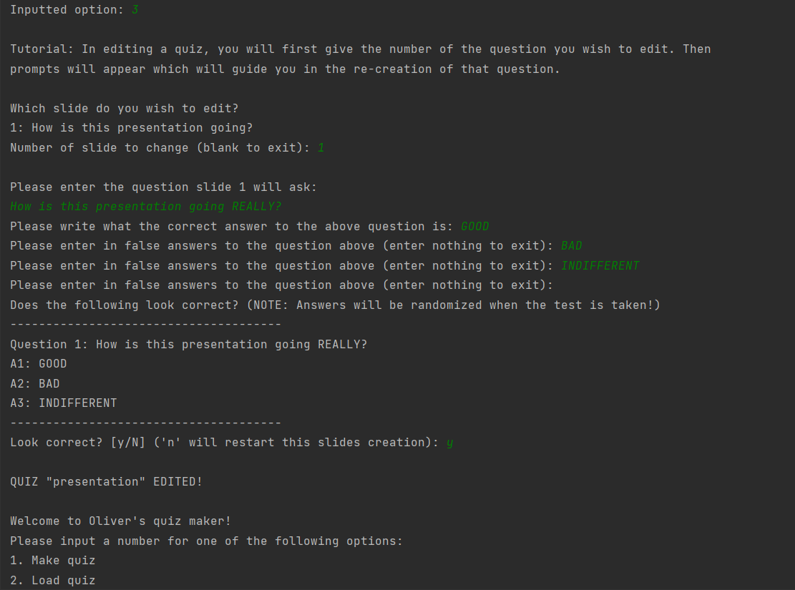
How does my Quiz Maker work?
When editing a quiz, a user will:
Choose a slide to change
Go through the same process as creation for a slide
Quiz will then be exported to CSV format

Slide 7
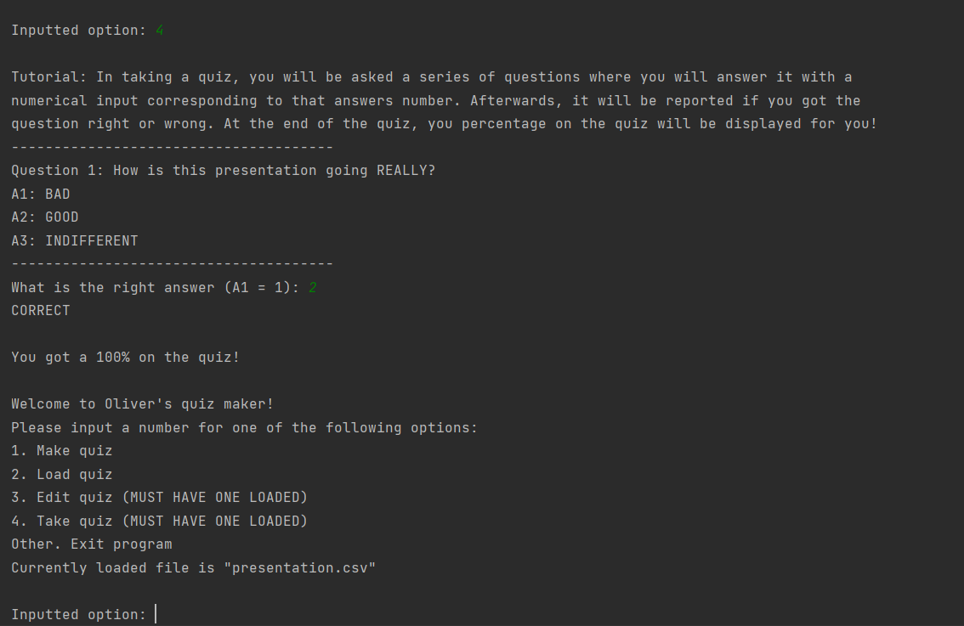
How does my Quiz Maker work?
When taking a quiz, a user will:
Answer a slide in numerical format
Recieve a score at the end

Slide 8
DEMO
The process you just saw, but LIVE

Slide 9
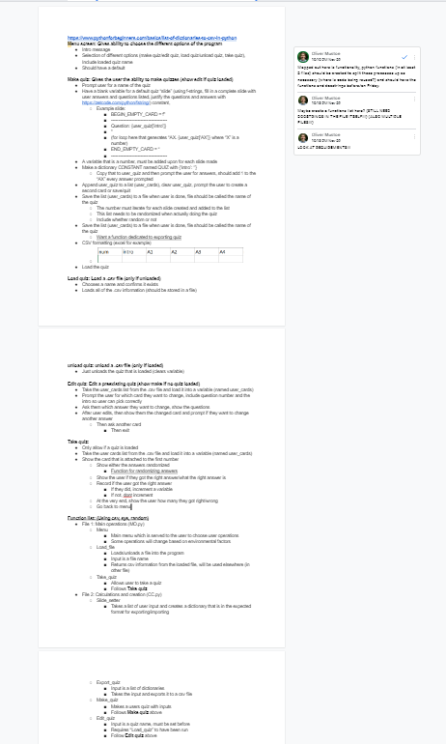
Significance of learning?
CSV
Learned a lot about how to manage CSV files, and create data structures that would nicely be able to be exported to this format.
Text-output
As this program relies heavily on text outputted to the screen, I had to spend a lot of time testing and ensuring that the right information was available to the user in a comprehensible way.
Pre-work organization
Because of this projects logical problems (moving data around in ways that NEED to be properly structured) spent a lot of time working on building out the programs workflow before even writing any code.
My planning document

Slide 10
Sources:
https://www.prnewswire.com/news-releases/quizlet-launches-new-explanations-to-provide-step-by-step-guidance-for-millions-of-study-questions-301357556.html

